Slide 1
TITLE:

Slide 2
ABSTRACT:
Breast cancer is one of the burning issue all over the world. The disease represents the main cause of cancer death among women. Breast cancer occurs when some breast cells begin to raise abnormally. It can arise in any portion of the Breast and it can be prevented if the treatment is started at the early stage of the Breast cancer. Breast cancer is a malignant tumour i.e. a collection of cancer cells arising from the cells of the breast Treatment of breast cancer relies on the cancer type and its stage (zero to fourth) and may include surgery, radiation, or chemotherapy. Diagnosing the Breast cancer disease using various classification algorithm with the help of data mining tools are being formulated.
Naïve Bayes,
Random Forest,
Logistic Regression,
Multilayer Perceptron,
Knearest neighbors are used for the prediction of existence of Breast cancer.
Data set has been explored in terms of Kappa Statistics, TP rate, FP Rate and precision.

Slide 3
INTRODUCTION:
Breast cancer is a second main cause of cancer death in women after lung cancer. Breast cancer is developed from breast tissue. Breast cancer typically attack postmenopausal women. About 5-10% of breast cancer are hereditary and occur in the patient with mutation BRCA1, BRCA2 genes [1]. Prolong estrogen exposure associated with early menarche, late menopause uses of hormone replacement therapy (HRT) has been associated with increased risk. Breast cancer usually present as a Palpable mass with nipple discharge. Breast cancer may metastasis to bone (70%), lung (60%), liver (55%) and other organs. Signs include:
breast lump,
skin dimpling,
fluid coming from the nipple,
breast shape change,
a newly inverted nipple,
a scaly patch of skin.

Slide 4
MINIMAL CLASSIFICATION RULES FOR DIAGNOSIS:
A rule based classifier is widely applied in breast cancer diagnosis. The classifier with a good performance of disease classification have been developed. The classifier equips with high accurate classification rules obtaining from historical diagnosis. Since each diagnosis consists of a large amount of data features, it challenges to build minimal high accurate classification rules from such historical data. Since classification rules are derived from previous diagnosis with a large amount of features, it challenges to build a minimal number of rules with high performance while retaining all diagnosis information. J48 decision tree classifier is found to be the best among the three classifiers: J48 decision tree, Reduced Error Pruning Tree, and Random Tree.
Main aim is to find the best performance classifier giving minimal classification rules.

Slide 5
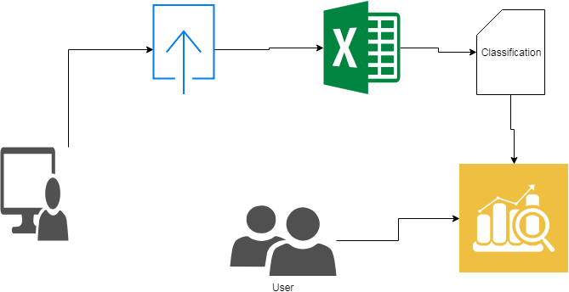
ARCHITECTURE DIAGRAM:

Slide 6
SYSTEM CONFIGURATION:
Hardware requirements:
Processer : Any Update Processer
Ram : Min 4 GB
Hard Disk : Min 100 GB
Software requirements:
Operating System : Windows family
Technology : Python 3.6
IDE : PyCharm
UML : Star UML

Slide 7
ADVANTAGES AND DISADVANTAGES:
Advantages:
We can predict the results using rule-based classifier.
Dynamic nature in prediction.
Disadvantages:
No analysis of the previous data.
Simple statistical solutions.

Slide 8
FUNCTIONAL REQUIREMENTS:
Admin: we have to login with admin details
Dataset upload: data set uploading in a given manner
Viewdataset: data which we have given It is shown
Classification:there has been classified
Evaluations: evaluating the the things
User we have to login with our details
Prediction: predict the following substances

Slide 9
EXISTING SYSTEM
Machine learning can be used to determine the automatic conclusion of diagnostic rules from the past descriptions, experts and specialists will help make the diagnostic process more objective and more reliable.

Slide 10
PROPOSED SYSTEM
Classification is a process related to categorization, the process in which ideas and objects are recognized, differentiated, and understood. Rule-based classifier makes use of a set of IF-THEN rules for classification. . A rule based system for breast cancer diagnosis has been a powerful tool supporting doctor diagnosis. Such a system requires classification rules derived from historical diagnosis. The desirable rules should be minimal in their number and give a good performance. It performes experiments on the data set to determine the best classifier among J48 decision tree, and Random Tree.

